Slide 1

UMD AGENTIC AI CHALLENGE · 2026
Huddle Serendipity Agent
Solving the Campus Event Crisis
Autonomous event intelligence that connects the right student to the right event — before it's too late.
TEAM: HUDDLE AI OPS

Slide 2

THE PROBLEM
Great Events. Nobody Shows Up.
40–60%
32%
No-show rate Validated by Dingman Center
Students miss events they never knew about NSSE 2023
Reactive Tools
Chats, Luma, Eventbrite — destinations, not solutions

Slide 3

THE PROBLEM
This Is an Institutional ROI Problem
Attendance = Retention
Students who attend one campus event are significantly more likely to persist and graduate.
The Stakes
Every no-show is a missed connection — and a potential tuition revenue loss for the institution.

Slide 4

THE SOLUTION
Perceive → Reason → Act
A three-agent autonomous pipeline — zero human intervention required.
Perceive
Reason
Act
Each agent passes structured output to the next stage — a fully autonomous loop from detection to delivery.

Slide 5
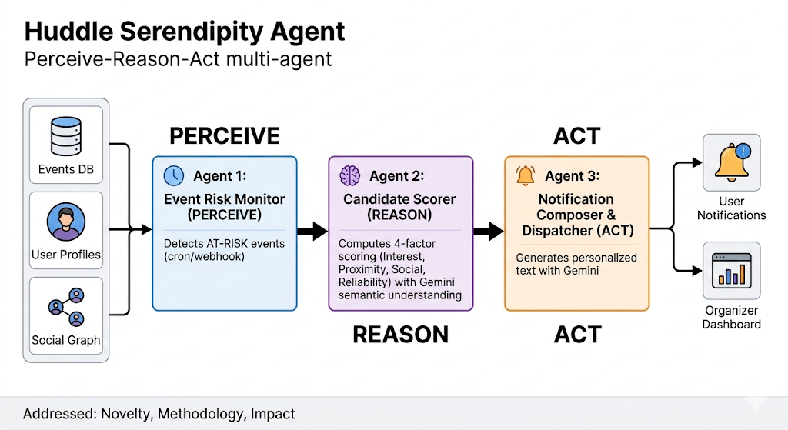
AGENT ARCHITECTURE
Three Specialized Agents
Agent 1: Risk Monitor
Perceive — Detects at-risk events via cron and webhook triggers.
Agent 2: Candidate Scorer
Reason — Computes weighted match scores using Gemini semantic understanding.
Agent 3: Notification Dispatcher
Act — Dispatches personalized, timely interventions to the right students.

Slide 6
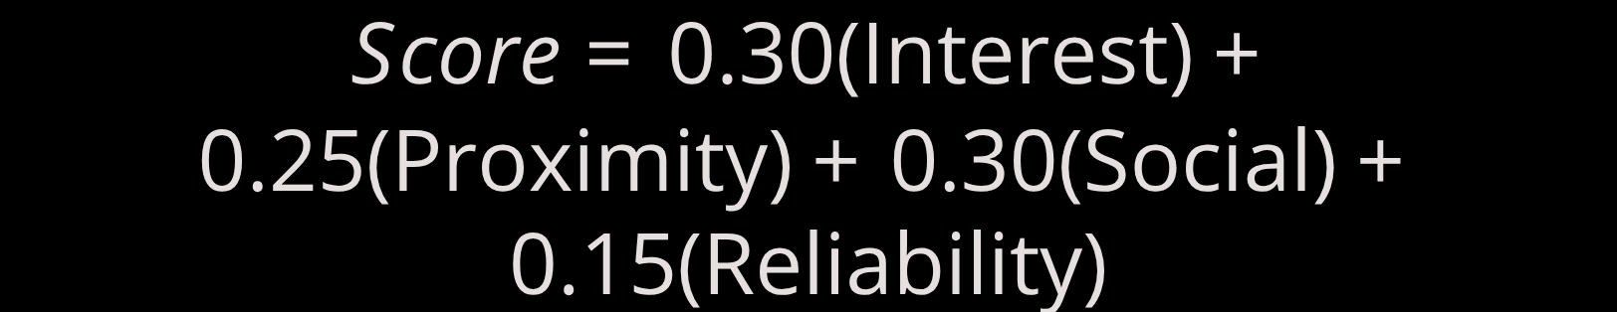
AGENT REASONING
Advanced Reasoning, Not Basic Rules
The Scoring Formula
Semantic Matching
O(1) Geo Lookup
GeoFire-common Set-based proximity and friend-list queries
Gemini API maps "wellness" → "yoga on the quad"
Every candidate is ranked across four weighted dimensions — not a simple yes/no filter.

Slide 7
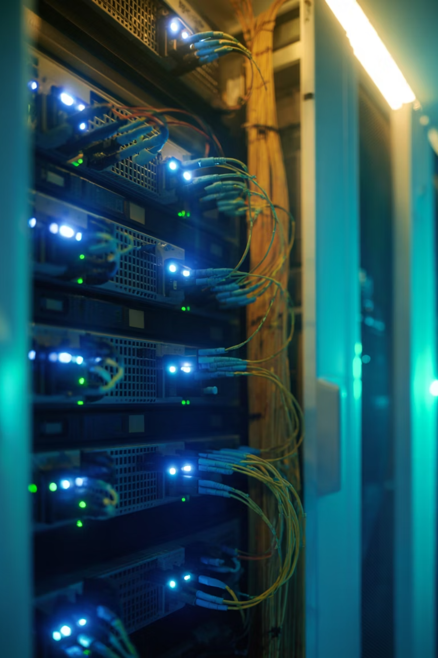
PRODUCTION READY
Live Stack. Real Scale.
Next.js + Vercel
Production deployment
Firebase
Real-time data layer
Gemini 2.5 Flash
Lowest-cost Google model
GeoFire-common
O(1) proximity engine

Slide 8
COST & ROI
Pennies a Day. Millions in Value.
$3.50
$4.8M
1K
Monthly Operating Cost
Retention Value Preserved
Weekly Active Users
For 1,000 weekly active users at UMD scale
With just a 1% improvement in student retention
Target UMD deployment scale

Slide 9
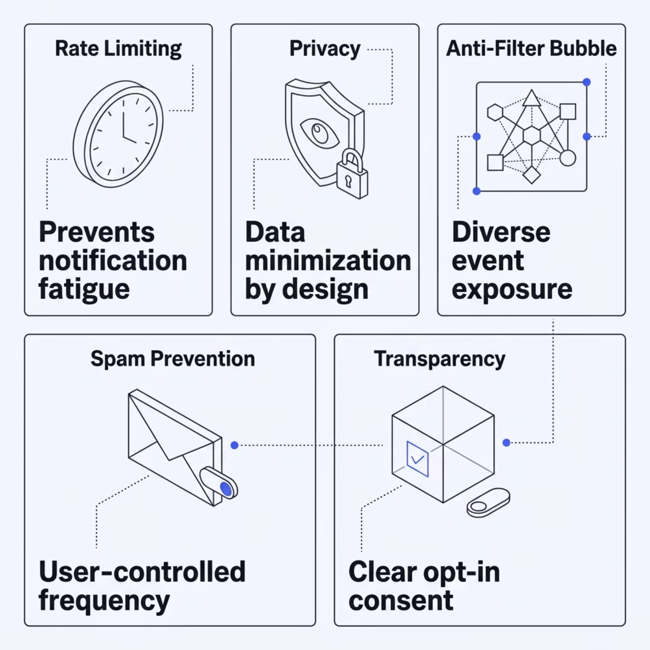


SAFETY & ETHICS
Built-In Guardrails
Responsible by Design
Every agent operates within strict ethical boundaries — protecting students while maximizing engagement.
Five risk categories addressed from day one, not added as an afterthought.

Slide 10

LIVE NOW
We Don't Just Find Events. We Make Them Happen.
The Huddle Serendipity Agent is live in production — solving the no-show problem at scale.
🌐 Live Demo
🏗️ Stack
huddlemap.live
Vercel · Next.js · Firebase
🤝 Team
Huddle AI Ops

